Slide 1


STUDENT INDUSTRIAL PROJECT (SIP)
Data Collection Scripts and Contact Resistance (CRES)/Spring Rate Measurement Tool for In-Circuit Tester (ICT) Fixture Probe Health Maintenance and Life Extension
Name : Shahidan bin Idris
Student ID : 25204
Programme : Electrical & Electronics Engineering
HC SV : Goh Fong Hsia, Test Manager
UTP SV : Dr Cheng-Kai Lu
16.12.2020 WW51.3’2020

Slide 2

Table of Contents
Introduction 3
Problem Statement 4
Objectives 5
Methodology 7
Results & Discussion 34
Conclusion 36
Recommendations 37
16.12.2020 WW51.3’2020

Slide 3
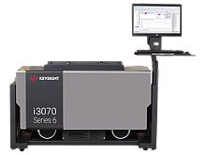
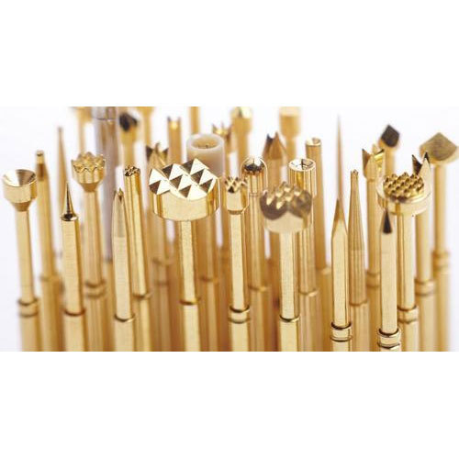
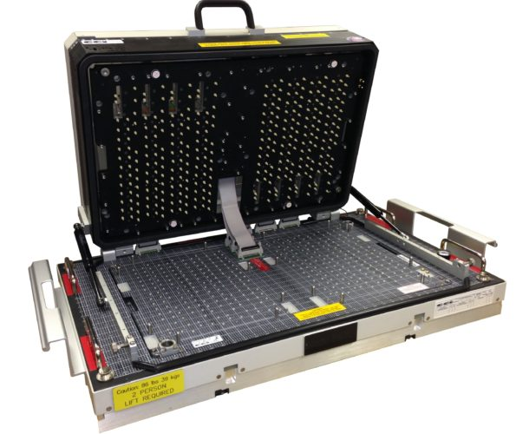
Introduction – Background
Parametric Test – In-Circuit Tester (ICT)
Detection of manufacturing defects on Printed Circuit Board (PCB)
ICT Test Performance Issues
False-call healthy PCB
Fail to detect defects (No-Defect-Found)
High No-Defect-Found (NDF) Rate Issue
Suspected root cause: Probe failure
In-Circuit Test (ICT) Machine
How do we PROVE it’s Probe Failure issue?
If so, how do we MAINTAIN probe health?
If probes are replaced when healthy, can we potentially EXTEND probe lifespan beyond probe cycle count limit (replacement limit), to prevent probe wastage?
ICT Fixture Probe
ICT Fixture
16.12.2020 WW51.3’2020

Slide 4
Problem Statement
Opportunities
Lack of centralised database to store and retrieve historical ICT fixture preventive maintenance (PM) reports
Difficulty to display fixtures that need reprobing (exceed cycle count limit) from Hardware Probe Cycle Count recorded in PM reports
Difficulty to retrieve Software Probe Cycle Count from all product folders on tester PC into a single dashboard
Lack of traceability for probes replaced and failure modes causing replacements during production
Lack of method and device to measure electrical and mechanical properties of fixture probes to determine probe health
Set up Centralised database for historical PM reports
Collect Hardware Probe Cycle Count from historical PM reports
Collect Software Probe Cycle Count from product folders in tester PC
Display fixtures that exceed Cycle Count Limit
Trace Probes Replaced and Failure Modes
Measure Electrical and Mechanical properties of replaced probes
16.12.2020 WW51.3’2020

Slide 5
Objectives
Set up centralised database to store and retrieve historical ICT fixture preventive maintenance (PM) reports
Collect Hardware Probe Cycle Count from PM reports and display fixtures that need reprobing
Collect Software Probe Cycle Count from individual product folders on tester PC into a single dashboard
Track probe replacements and failure modes causing replacements during production
Enable capability to measure electrical and mechanical properties of fixture probes that indicate probe health
16.12.2020 WW51.3’2020

Slide 6
Tasks
Centralised database for historical PM reports
Collect Hardware Probe Cycle Count from historical PM reports
Collect Software Probe Cycle Count from product folders in tester PC
Display fixtures that exceed Cycle Count Limit
Trace Probes Replaced and Failure Modes
Measure Electrical and Mechanical properties of replaced probes
16.12.2020 WW51.3’2020

Slide 7





Methodology
ICT Fixture PM Report Generation Tool
Tools: Python, pandas, PySimpleGUI, matplotlib, Pyinstaller
Generate Executable File
(.exe file)
Pyinstaller
16.12.2020 WW51.3’2020

Slide 8





Methodology
ICT Fixture Preventive Maintenance (PM) Report Generation Tool
Tools: Python, pandas, PySimpleGUI, matplotlib, Pyinstaller
PM Report
Generated
Data feature for probe health
Store onto
network drive
Export Data Table
with printed images to PDF
Hardware Cycle Count
PM Activity Report Data
Pareto Plot
Generated
PM Crew
Image
Files
Images/Photos from
PM activity
16.12.2020 WW51.3’2020

Slide 9
Methodology
ICT Fixture Preventive Maintenance (PM) Report Generation Tool
Tools: Python, pandas, PySimpleGUI, matplotlib, Pyinstaller
PM Report
Generated
Data feature for probe health
Store onto
network drive
Export Data Table
with printed images to PDF
Hardware Cycle Count
PM Activity Report Data
Pareto Plot
Generated
PM Crew
Image
Files
Images/Photos from
PM activity
16.12.2020 WW51.3’2020

Slide 10
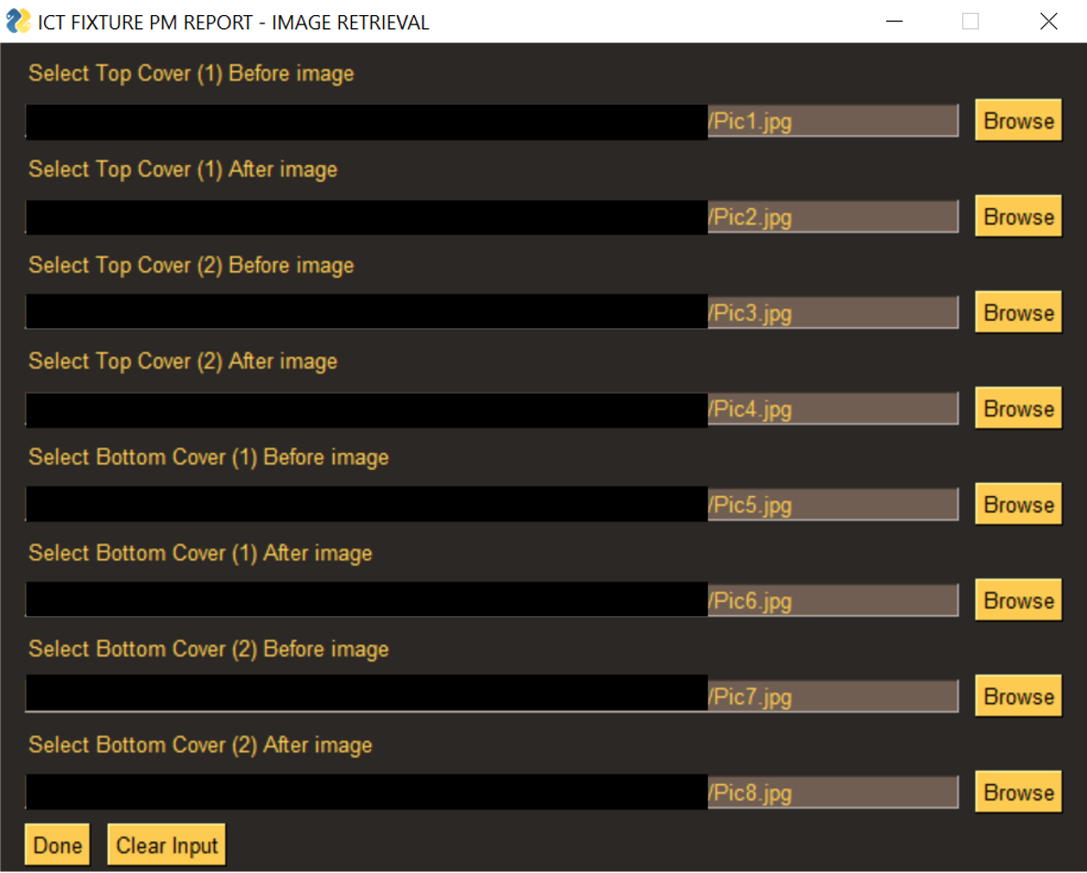
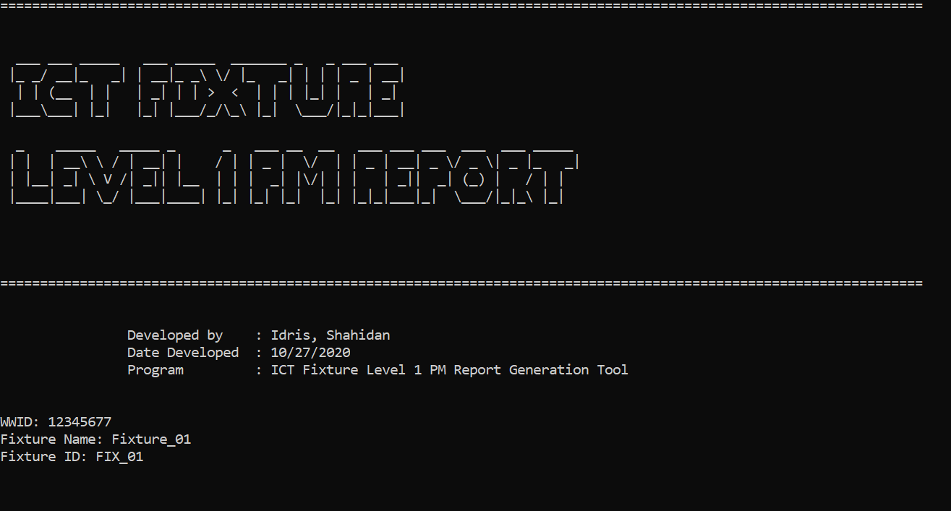
Tool Interface
First Page of Tool Menu
GUI for uploading images
16.12.2020 WW51.3’2020

Slide 11
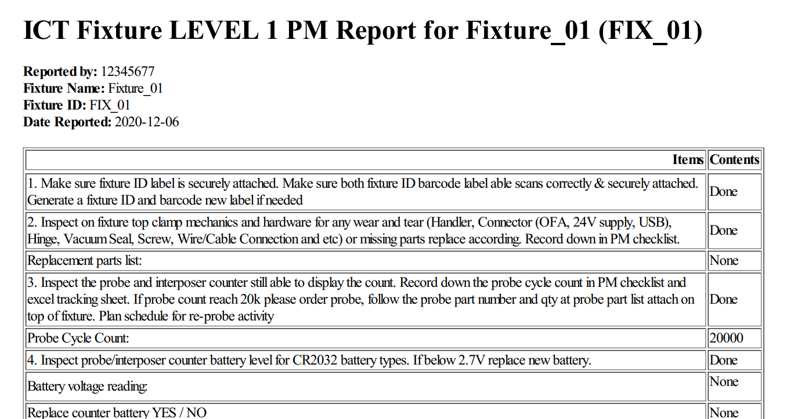
Tool Output (Report Generation)
Generated PM Report in PDF Format
16.12.2020 WW51.3’2020

Slide 12
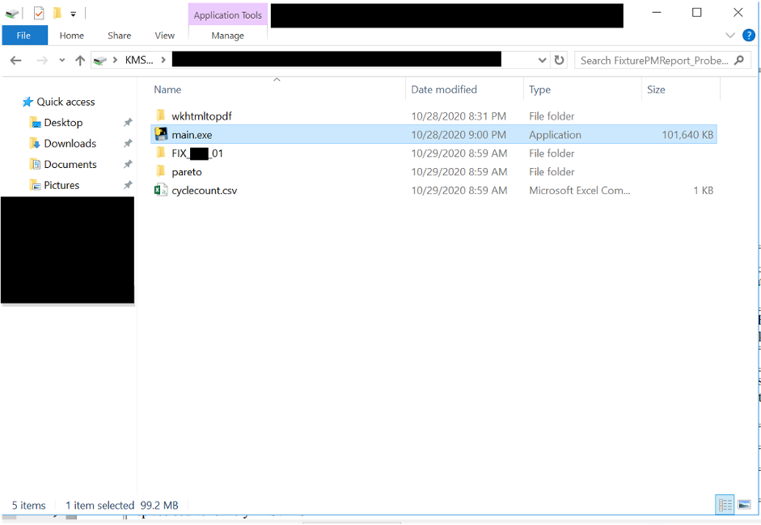
Network Drive
Generated Fixture Folder containing Report and Pareto Plot folder in Network Drive
16.12.2020 WW51.3’2020

Slide 13
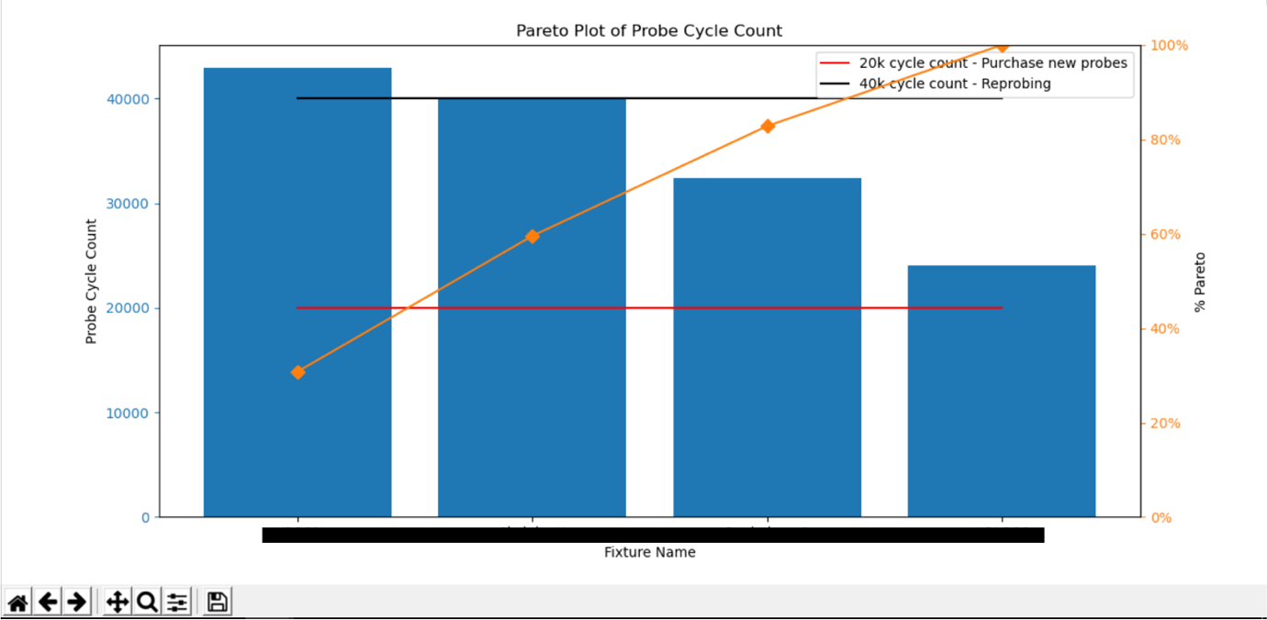
Pareto Chart
Pareto Chart of Top Probe Cycle Counts for Fixtures with Limit Lines
16.12.2020 WW51.3’2020

Slide 14
Tasks
Centralised database for historical PM reports
Collect Hardware Probe Cycle Count from historical PM reports
Collect Software Probe Cycle Count from product folders in tester PC
Display fixtures that exceed Cycle Count Limit
Trace Probes Replaced and Failure Modes
Measure Electrical and Mechanical properties of replaced probes
16.12.2020 WW51.3’2020

Slide 15
Methodology
Probe Cycle Count Harvesting Script
Tools: Python, pandas, Pyinstaller
Generate Executable File
(.exe file)
Pyinstaller
16.12.2020 WW51.3’2020

Slide 16


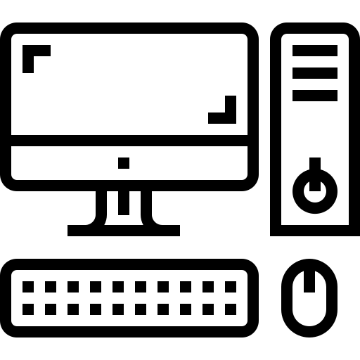

Methodology
Probe Cycle Count Harvesting Script
Tools: Python, pandas, Pyinstaller
Data feature for probe health
Software Probe Cycle Counts
Product A
Product B
Tester PC
Harvesting Script
One-glance table
of fixtures and
software cycle counts
Product C
Counter Files
16.12.2020 WW51.3’2020

Slide 17
Methodology
Probe Cycle Count Harvesting Script
Tools: Python, pandas, Pyinstaller
Data feature for probe health
Software Probe Cycle Counts
Product A
Product B
Tester PC
Harvesting Script
One-glance table
of fixtures and
software cycle counts
Product C
Counter Files
16.12.2020 WW51.3’2020

Slide 18
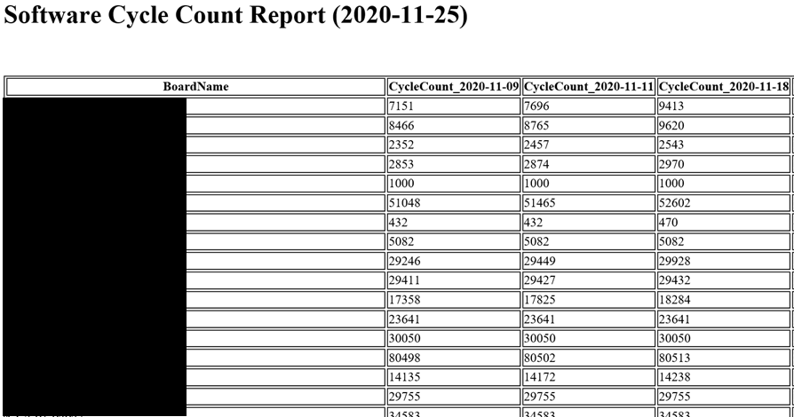
Software Cycle Count Table (HTML File)
HTML File of Table of Software Probe Cycle Counts of each fixture by dates
16.12.2020 WW51.3’2020

Slide 19
Tasks
Centralised database for historical PM reports
Collect Hardware Probe Cycle Count from historical PM reports
Collect Software Probe Cycle Count from product folders in tester PC
Display fixtures that exceed Cycle Count Limit
Trace Probes Replaced and Failure Modes
Measure Electrical and Mechanical properties of replaced probes
16.12.2020 WW51.3’2020

Slide 20
Methodology
Probe Replacement Tracking Tool
Tools: Python, pandas, PySimpleGUI, matplotlib, Pyinstaller
Generate Executable File
(.exe file)
Pyinstaller
16.12.2020 WW51.3’2020

Slide 21
Methodology
Probe Replacement Tracking Tool
Tools: Python, pandas, PySimpleGUI, matplotlib, Pyinstaller
Fixture Probe List
contains:
probe size
probe coordinates
net name, etc
Data feature for probe health
Finds and matches Probe Data
Full Probe Replacement Tracking Data
Key in
Fixture ID
Probe ID
Failure Modes
Populate with engineering data
Bar Chart of
Top Probe ID replaced
Top Failure Modes
Exports Data Table to CSV
+
Technician
Tracking Tool with GUI
16.12.2020 WW51.3’2020

Slide 22
Methodology
Probe Replacement Tracking Tool
Tools: Python, pandas, PySimpleGUI, matplotlib, Pyinstaller
Fixture Probe List
contains:
probe size
probe coordinates
net name, etc
Data feature for probe health
Finds and matches Probe Data
Full Probe Replacement Tracking Data
Key in
Fixture ID
Probe ID
Failure Modes
Populate with engineering data
Bar Chart of
Top Probe ID replaced
Top Failure Modes
Exports Data Table to CSV
+
Technician
Tracking Tool with GUI
16.12.2020 WW51.3’2020

Slide 23
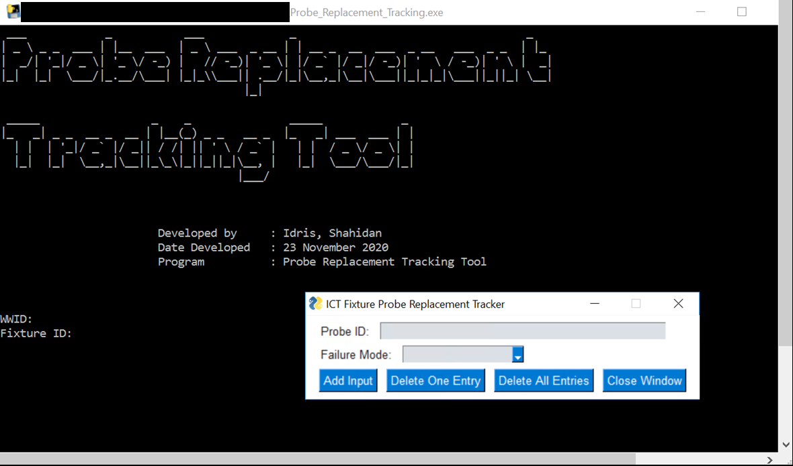
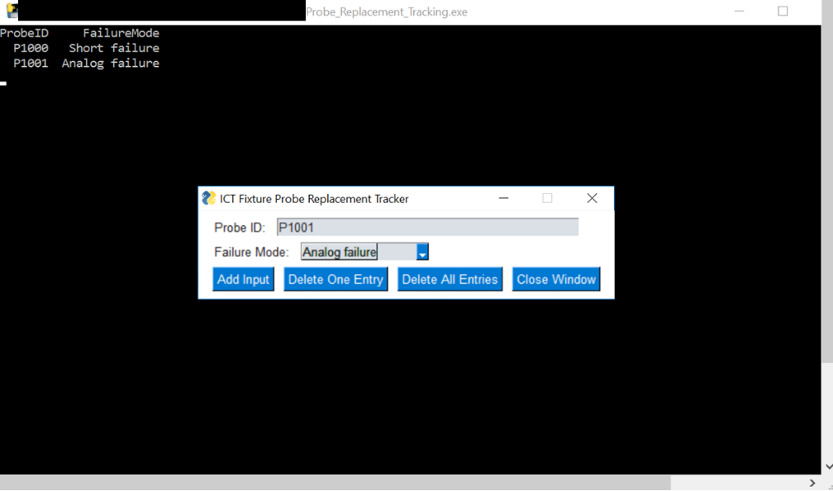
Tool Interface
First Page requesting employee ID and Fixture ID
Probe ID and Failure Mode Entry
16.12.2020 WW51.3’2020

Slide 24
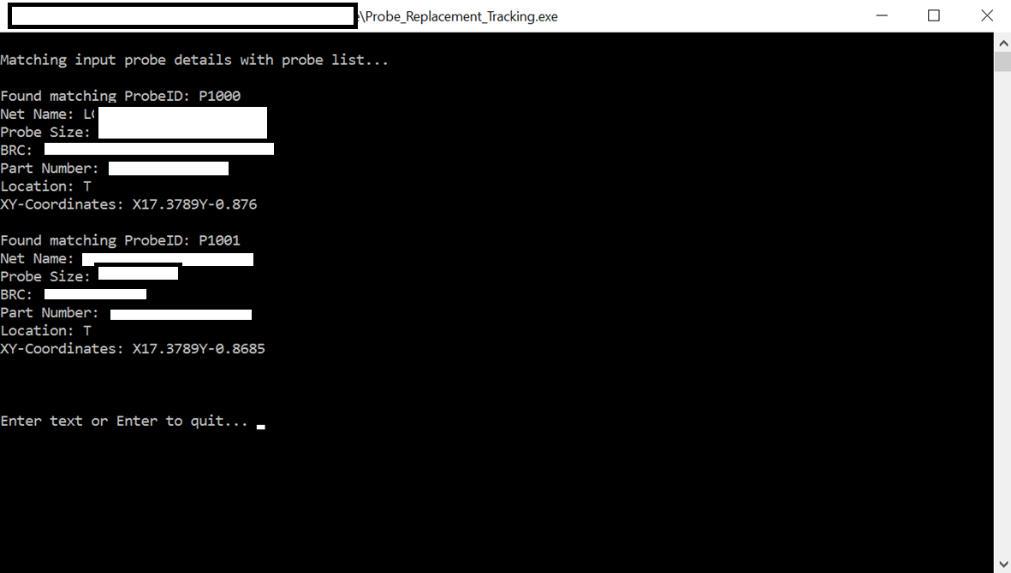
Probe ID – Probe Data Matching
Probe ID and Probe Data matching from Probe Lists
16.12.2020 WW51.3’2020

Slide 25
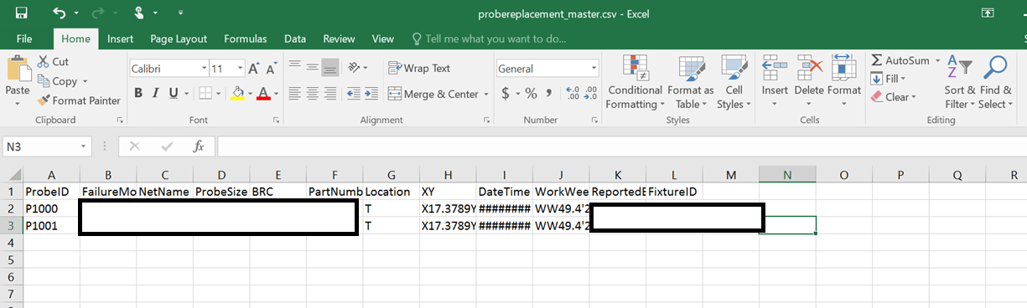
Master CSV File with Probe Data
Master CSV file containing all necessary Probe Data features for Engineering Study
16.12.2020 WW51.3’2020

Slide 26
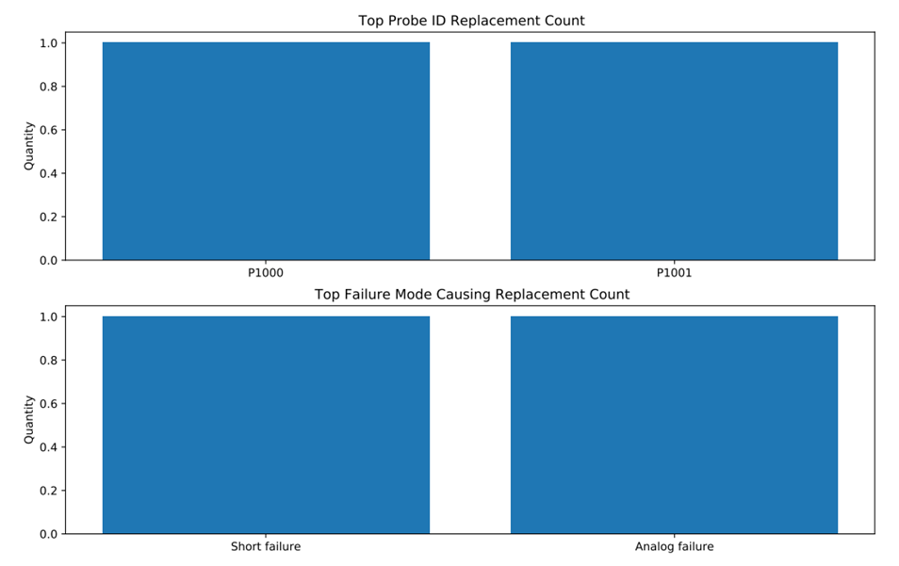
Bar Chart for Top Probe ID and Failure Mode
Bar Charts showing Top Probe ID replaced and Top Failure Modes
16.12.2020 WW51.3’2020

Slide 27
Tasks
Centralised database for historical PM reports
Collect Hardware Probe Cycle Count from historical PM reports
Collect Software Probe Cycle Count from product folders in tester PC
Display fixtures that exceed Cycle Count Limit
Trace Probes Replaced and Failure Modes
Measure Electrical and Mechanical properties of replaced probes
16.12.2020 WW51.3’2020

Slide 28
Methodology
CRES/Spring Rate Measurement Device
Directly measure electrical & mechanical properties of ICT fixture probes
First Designs
Electronic Load Cell – Strain Gauge (force sensor) with Wheatstone Bridge Configuration
Linear Variable Differential Transformer (LVDT) – measures Spring Travel (displacement)
4-wire Kelvin measurement – measures Contact Resistance
Overall measurement mechanism for CRES, Spring Force and Spring Travel measurement
Engaged vendor support for device development
Project team provided first designs and measurement ranges (Scope of Work)
Vendor provided their device designs and quotation
16.12.2020 WW51.3’2020

Slide 29
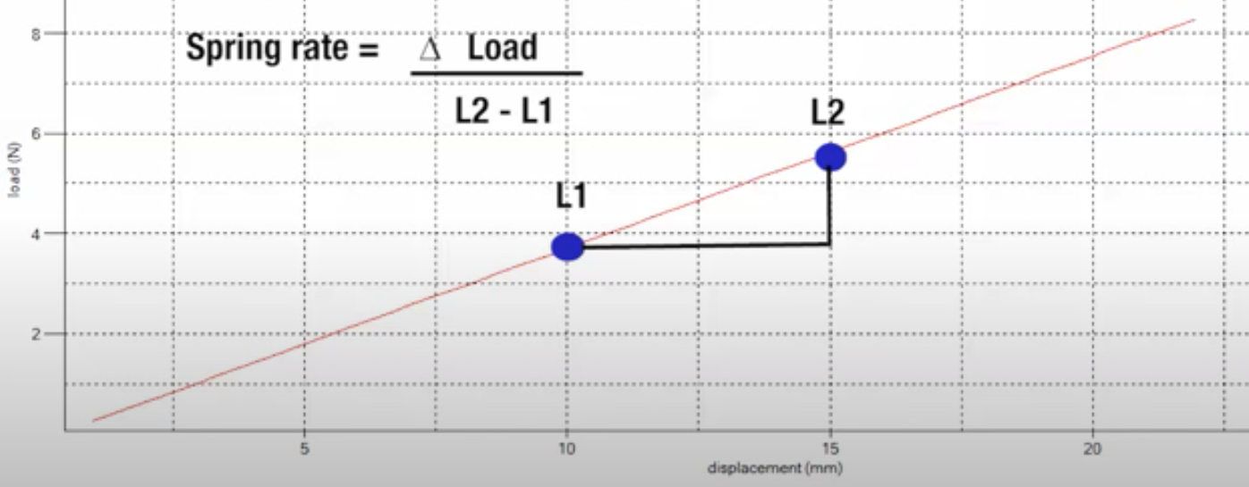

Spring Rate Measurement Mechanism
Force applied
$$\text{Spring} \text{Rate}=\frac{\text{Spring} \text{Force}}{L2 −L1}=\frac{\text{Spring} \text{Force}}{d}$$
Load
Force sensor
L1
d
Reactive force (Spring Force)
L2
Probe
Source: https://www.youtube.com/watch?v=A4wezoZmoyA
Designed Mechanism for measuring probe Spring Rate
16.12.2020 WW51.3’2020

Slide 30


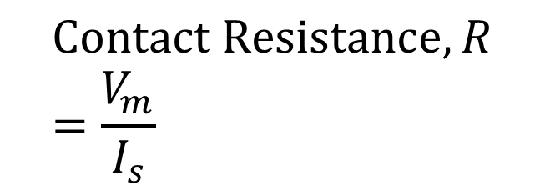







CRES Measurement Mechanism
$$R_{wire1}$$
$$I_{s}$$
$$I_{m}≈0A$$
A
$$R_{m1}$$
$$\text{Contact} \text{Resistance}, R=\frac{V_{m}}{I_{s}}$$
V
$$V_{m}$$
$$I_{s}$$
$$R_{m2}$$
Probe
$$R_{wire2}$$
CRES Measurement Mechanism using 4-wire Kelvin Measurement
16.12.2020 WW51.3’2020

Slide 31
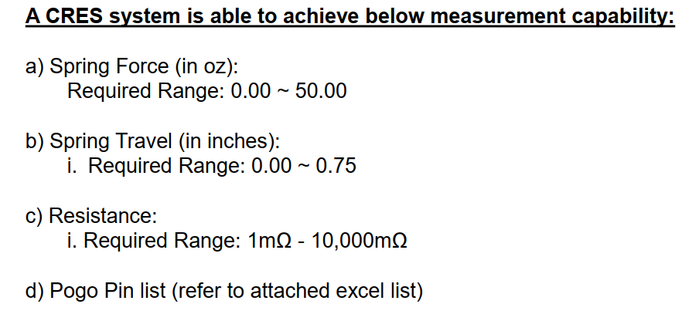
Measurement Ranges for Device
16.12.2020 WW51.3’2020

Slide 32
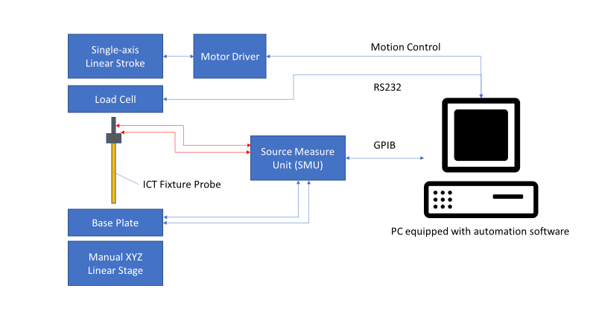
Vendor Device Designs
Functional Block Diagram of Measurement Device
16.12.2020 WW51.3’2020

Slide 33
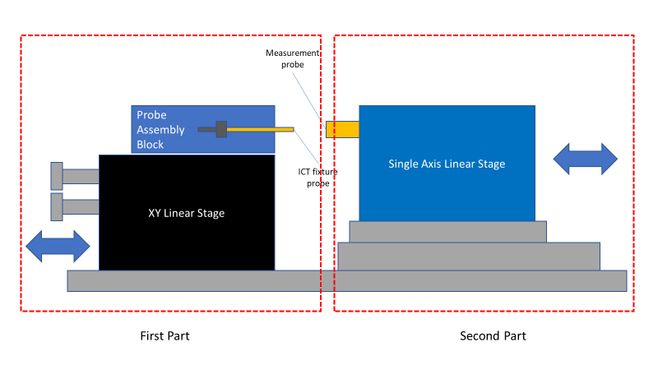
Vendor Device Designs
Test Setup Diagram
16.12.2020 WW51.3’2020

Slide 34
Overall Project Results & Discussion
Data Collection Scripts
Hardware Probe Cycle Count
Software Probe Cycle Count
Probe Specification
Failure Mode
CRES/Spring Rate Measurement Device
Direct measurement of electrical & mechanical properties
}
Estimate of Probe Usage/Lifespan/Health
}
Probe Characteristics and Replacement Observation
→ Direct Measurement of Probe Health
16.12.2020 WW51.3’2020

Slide 35
Overall Project Results & Discussion
ICT Fixture PM Report Generation Tool
Fixture ID
Hardware Probe Cycle Count
Probe Cycle Count Harvesting Script
Fixture ID
Software Probe Cycle Count
Probe Health
Fixture ID
Probe ID
Expected/Estimated Probe Lifespan
Current Probe Health Ratio (Days Left/Total Lifespan)
Probe Replacement Tracking Tool
Fixture ID
Probe ID
Net Name
Probe Size
BRC #
Probe Part Number
Probe Location
Probe Coordinates
END GOAL
CRES/Spring Rate Measurement Device
Fixture ID
Probe ID
Contact Resistance (Ω)
Spring Rate (oz/inch)
The Benefits
Spend less money on replacing actually healthy probes
Predict probe failures before running into issues during production
16.12.2020 WW51.3’2020

Slide 36
Conclusion
No-defect-found (NDF) rate suspected to be caused by Probe Failures
Require Data Collection to prove if probes are TRULY failed
Data Collection Scripts and CRES/Spring Rate Measurement Device
Gathers Probe Cycle Count → Estimate of probe health
Measures CRES/Spring Rate → Direct measurement of probe properties
By understanding and calculating Probe Health accurately, we can
Identify potential probe failures before running probes in production (issue/troubleshooting time savings)
Use probes beyond the Cycle Count Limit since they are healthy (save money purchasing probes)
Quantitatively prove probe failure as root cause of high NDF rates (investigation data)
16.12.2020 WW51.3’2020

Slide 37
Recommendation
Merging of all Data Collection Tools into A Single Software
While the functions and impact area is slightly different, overall, the tools still help ICT
Can reduce confusion of so many tools, while helping with data integration from all data features
Implementing Aesthetic Look into the Software using GUI-Based Software
While software is for internal (company) use, aesthetic will give better appeal to use
Convert software into full GUI (clickable menus, widgets), better designs
Explore Possible Alternatives of Measuring CRES and/or Spring Rate before Full Device
Project development is limited by lacking Return of Investment (ROI)
Current factory procedures does not allow reuse of replaced probes (project is ‘ahead of its time’)
To save on costs from vendor quotations, can consider exploring other methods of directly measuring CRES/Spring Rate without device (or get reliable close estimate)

Slide 38
Thank You
Q&A
16.12.2020 WW51.3’2020

